Slide 2
Overview
New terms
Term edits
Deprecated & undeprecated terms
Other updates

Slide 3
1060 New LOINC terms for 2.60
590 lab
329 clinical
141 survey

Slide 4
590 new laboratory terms
~400 in the MICRO class
Includes 260 Streptococcus pneumoniae Danish serotype terms (more on this later)
Veterinary terms
76 in the PATH class
CAP Colorectal cancer panel
CAP Breast cancer panel
34 in ABXBACT
Bacterial resistance gene terms
Handfuls in CHEM, DRUG/TOX, HEME, BLDBNK, etc.

Slide 5
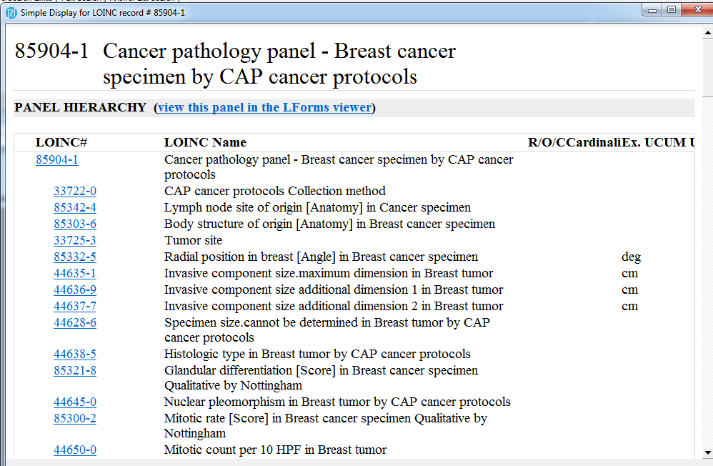
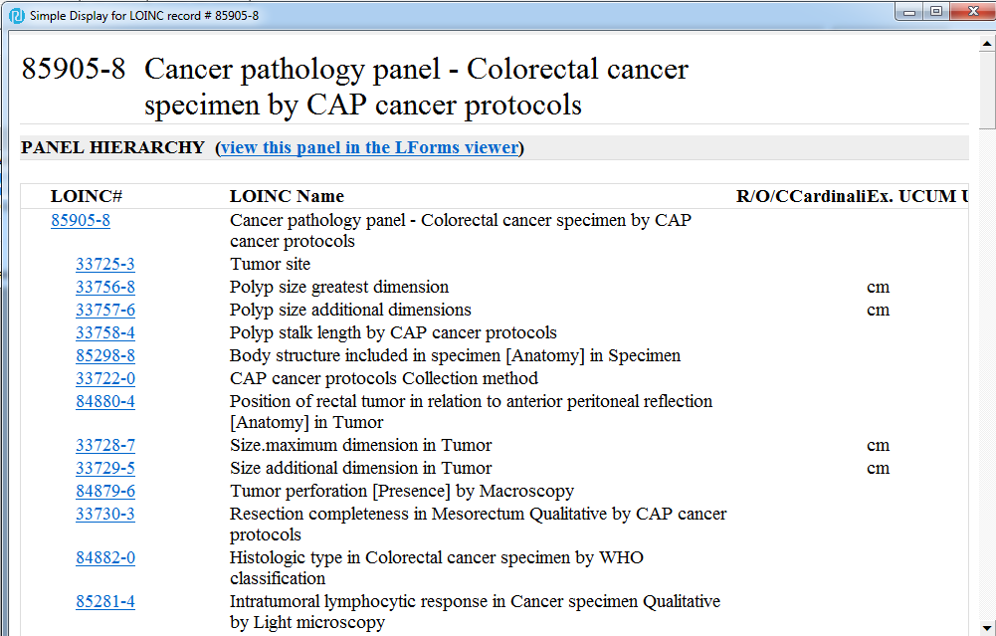
Laboratory term highlights
CAP Colorectal and breast cancer panels

Slide 6
Laboratory term highlights (cont.)
Veterinary terms
Mycoplasma flocculare
Mycoplasma hyopneumoniae DNA
Porcine reproductive and respiratory syndrome virus North American strain RNA
Porcine reproductive and respiratory syndrome virus European strain RNA
Porcine reproductive and respiratory syndrome virus Ingelvac MLV strain ORF5 gene
Porcine reproductive and respiratory syndrome virus Ingelvac ATP strain ORF5 gene
Porcine epidemic diarrhea virus S INDEL strain S gene
Porcine epidemic diarrhea virus prototype strain S gene

Slide 7
329 new clinical terms
110 new RAD terms to match Fluoroscopy and Mammography terms in the RSNA Playbook
100 document ontology terms
~50 new terms for clinical history concepts related to CDC case reporting
Rubella
STDs
Renal replacement therapy goals panel (in collaboration with NIDDK)
Retinal nerve fiber layer thickness panel

Slide 8
141 new survey terms
Primarily for CMS Assessments
Long-Term Care Hospital (LTCH) Continuity Assessment Record and Evaluation (CARE) Data Set (LCDS) - Planned Discharge - version 3.00
Inpatient Rehabilitation Facility – Patient Assessment Instrument (IRF-PAI) – version 1.4
Minnesota Living with Heart Failure Questionnaire (MLHFQ)
Kansas City Cardiomyopathy Questionnaire (KCCQ)

Slide 9
Nearly 7000 term edits
Components - 536
One of other major LOINC axes - 480
Other fields such as description, class, copyright – almost 6000

Slide 10
Component edits
Fairly even across term types
148 lab (mainly Strep pneumo)
191 clinical (mainly to make the “lookback period” representation consistent)
197 survey (mainly CMS)

Slide 11
Other major axis edits
46 lab (mainly PATH)
340 clinical (mostly RAD)
94 survey (mainly CMS)

Slide 12
6000 other edits
Descriptions, public change reasons, class, copyright, etc.
5000 for RAD terms

Slide 13
Deprecated & Undeprecated terms
265 terms deprecated
Nearly all are Strep pneumo terms
12 California encephalitis virus terms undeprecated
Had been deprecated a few years ago because thought to be the same as La Crosse Virus
Upon further review, confirmed to be a distinct species in the CAL serogroup along with LaCrosse virus (LACV), Jamestown Canyon virus (JCV), Snowshoe Hare virus, and Trivitattus virus

Slide 14
Streptococcus pneumoniae project
Last fall, it was brought to our attention that Strep pneumo terms were ambiguous as to serotype designations
Two serotype numbering systems – U.S. and Danish
Serotype naming system (or the word “serotype”) not specified in Component
Some information in term descriptions and related names, but not consistent

Slide 15
Examples:
Ambiguous
Streptococcus pneumoniae 9
Serogroup 9?
U.S. serotype 9/Danish serotype 9N?
Streptococcus pneumoniae 33
Serogroup 33?
U.S. serotype 33/Danish serotype 9A?
Unambiguous
Streptococcus pneumoniae 51
Only possibility is U.S. serotype 51/Danish serotype 7F
Serogroup | Danish serotype | U.S. serotype
1 | 1 | 1
2 | 2 | 2
3 | 3 | 3
4 | 4 | 4
5 | 5 | 5
6 | 6A | 6
 | 6B | 26
 | 6C | 6C
 | 6D | 6D
 | 6Eb | NDc
 | 6F | 6F
 | 6G | 6G
 | 6H | 6H
7 | 7F | 51
 | 7A | 7
 | 7B | 48
 | 7C | 50
8 | 8 | 8
9 | 9A | 33
 | 9L | 49
 | 9N | 9
 | 9V | 68
33 | 33F | 70

Slide 16
Streptococcus pneumoniae project (cont.)
Reviewed all Streptococcus pneumoniae terms in LOINC
Determined which terms are ambiguous
Which ones are not ambiguous
Updated unambiguous terms to reflect Danish serotype (~80)
Deprecated ambiguous terms and mapped to a set of new terms that reflect Danish serotype (~230)

Slide 17
Streptococcus pneumoniae project (cont.)
Added Technical Brief regarding Strep pneumo naming in the LOINC Users’ Guide
Added part description
Added U.S. serotype number as a related name
Added vaccines to related names for relevant serotypes (“PCV7”, “PCV13”, “PPSV23”)
Component: “Streptococcus pneumoniae Danish serotype {#}…”

Slide 18
IEEE Collaboration update
No updates since last release
LOINC-IEEE mapping freely available with login on:
LOINC website as accessory file (https://loinc.org/downloads/accessory-files/)
NIST RTMMS site (https://rtmms.nist.gov/rtmms/index.htm#!hrosetta)
Also can search in RELMA or http://search.loinc.org for:
relatedcodes:IEEE* or relatedcodes:MDC_REL_HUMIDITY_MICROENV
Planning to work on remaining concepts in 11073-10101a before 2.62
Working closely with the HL7/IEEE workgroup on 10101b and 10101c content…will likely be balloted in 2017-2018, then added to LOINC

Slide 19
RSNA Collaboration update
Completed mapping for all modalities in the RSNA Core Playbook other than RP (modality-agnostic radiology procedures)
RP codes will be finished by the fall
Most of LOINC radiology codes have been updated per the LOINC/RSNA unified model
LoincRsnaRadiologyPlaybook file available as an independent download (https://loinc.org/downloads/accessory-files/)
Includes mappings between the LOINC radiology parts and RadLex codes for all LOINC radiology terms as well as the Core Playbook maps where relevant
Can search for Core Playbook maps using “coreplaybook:true”

Slide 20
CMS Assessment project update
LCDS AND IRF-PAI completed and in version 2.60 release
85654-2 Long-Term Care Hospital (LTCH) Continuity Assessment Record and Evaluation (CARE) Data Set (LCDS) - version 3.00 [CMS Assessment]
Admission
Planned discharge
Unplanned discharge
Expired
Inpatient Rehabilitation Facility – Patient Assessment Instrument (IRF-PAI) – version 1.4
Outcome and Assessment Information set (OASIS) submitted to CMS for review
Minimum Data Set (MDS) in process

Slide 21
Other content work
Agreement with CAP to represent all of CAP cancer protocols in LOINC
Beginning work with ICCR (International Collaboration on Cancer Reporting) on representing ICCR cancer protocols in LOINC
Preliminary discussion with AJCC (American Joint Committee on Cancer)
Work with NIDDK on terms related to chronic kidney disease
Fixing answer lists in preparation for first release
Mapping answer strings to SNOMED CT
Groups project
Special topics workgroups

